Slide 1
No attractors in Hamiltonian mechanics
no stable or unstable equilibrium, no dissipative motion

Slide 2
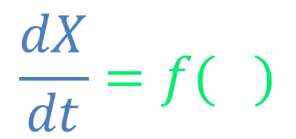
Elements of dynamical system theory
$$\frac{dX}{dt}=f(X)$$
displacement in time
state
no displacement
fixed region
fixed point
displacement within the region

Slide 3
Behavior around the region determines stability
neighbor points move toward the region
stable cycle
stable equilibrium
unstable equilibrium
unstable/stable directions
neighbor points move away
saddle
attractors are stable regions

Slide 4
In Hamiltonian systems
phase space area conservation means no flux through closed regions
Stable and unstable regions do not conserve phase space area

Slide 5
In Hamiltonian systems
phase space area conservation means no flux through closed regions
Stable and unstable regions do not conserve phase space area
Saddles are possible

Slide 6





$$p$$
$$H=\frac{p^{2}}{2m}+\frac{1}{2}kx^{2}$$
harmonic oscillator
$$x$$
$$\frac{dx}{dt}=\frac{1}{m}p$$
$$\frac{dp}{dt}=−kx$$
all cycles are semi-stable

Slide 7

$$p$$
no Hamiltonian
damped harmonic oscillator
$$x$$
$$\frac{dx}{dt}=\frac{1}{m}p$$
$$\frac{dp}{dt}=−kx−\frac{b}{m}p$$
areas shrink during evolution

Slide 8
Takeaway
Attractors, stable points or stable cycles, are regions around which trajectories concentrate
Dissipative forces are associated with attractors
Areas of phase space cannot shrink during Hamiltonian evolution
Hamiltonian evolution does not allow attractors

